Slide 1
Regression Analysis
Other Regression Methods
Nicoleta Serban, Ph.D.
Associate Professor
Stewart School of Industrial and Systems Engineering
Mixed Effects Models

Slide 2
About this lesson

Slide 3
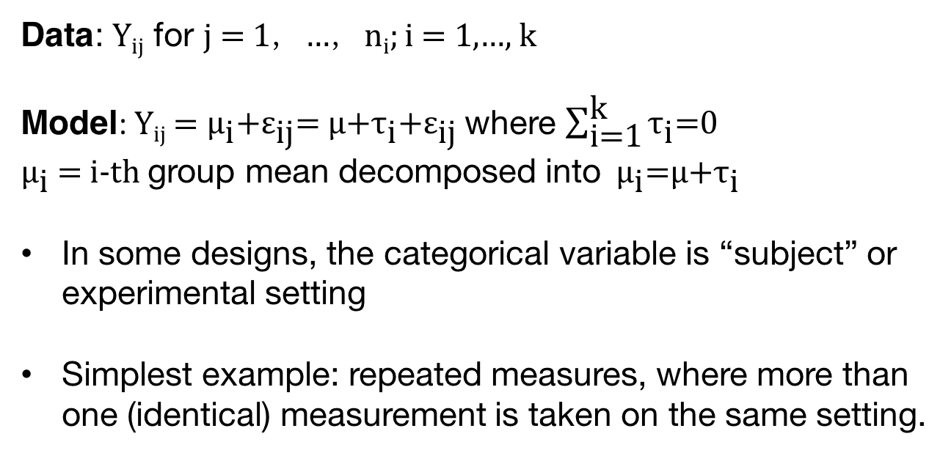
ANOVA Model
Data: Y_{ij} for j = 1，…，n_{i}; i = 1,…, k
Model: Y_{ij} = ${\text{μ}}_{\text{i}}\text{+}{\text{ε}}_{\text{ij}}\text{=}$ $\text{μ}\text{+}{\text{τ}}_{\text{i}}\text{+}{\text{ε}}_{\text{ij}}$where $\sum_{\text{i}\text{=1}}^{\text{k}}{{\text{τ}}_{\text{i}}\text{=}\text{0}}$
${\text{μ}}_{\text{i}}$ = i-th group mean decomposed into ${\text{μ}}_{\text{i}}$=$\text{μ}\text{+}{\text{τ}}_{\text{i}}$
In some designs, the categorical variable is “subject” or experimental setting
Simplest example: repeated measures, where more than one (identical) measurement is taken on the same setting.

Slide 4

ANOVA Model: Random Effects
Data: Y_{ij} j = 1，…，n_{i}; i = 1,…，k
Model: Y_{ij} = ${\text{μ}}_{\text{i}}\text{+}{\text{ε}}_{\text{ij}}\text{=}$ $\text{μ}\text{+}{\text{τ}}_{\text{i}}\text{+}{\text{ε}}_{\text{ij}}$where $\sum_{\text{i}\text{=1}}^{\text{k}}{{\text{τ}}_{\text{i}}\text{=}\text{0}}$
${\text{μ}}_{\text{i}}$ = i-th group mean decomposed into ${\text{μ}}_{\text{i}}$=$\text{μ}\text{+}{\text{τ}}_{\text{i}}$
${\text{ε}}_{\text{ij}}\sim N(0,σ^{2})$
${\text{τ}}_{\text{i}}\sim N(0,σ_{r}^{2})$
We might be interested in the in the variability across subjects, i.e. $σ_{r}^{2}$. Is it zero?
Are the assumptions the same as in ANOVA with fixed effects?
In random effects model, the observations are no longer
independent (even if the error terms are independent).

Slide 5
ANOVA Model: Random Effects
When to use random effects?
A “group” effect is random if we can think of the responses we observe in the group to be samples from a larger population.
Example: if collecting data from different medical centers, “center” might be thought of as random.
Example: if surveying students on different campuses, “campus” may be a random effect.

Slide 6

Regression Model: Mixed Effects
In some studies, some factors can be thought of as fixed, others random.
Suppose we study the effect of a blood pressure meant to lower blood pressure over time and we study r patients.
For each patient we record BP at regular intervals over a week (every day, say).
Model: Y_{ij} = $\text{μ}{\text{+}\text{τ}}_{\text{i}}\text{+}α X_{ij}\text{ +}{\text{ε}}_{\text{ij}}$
${\text{ε}}_{\text{ij}}\sim N\left(0,σ^{2}\right)$
${\text{τ}}_{\text{i}}\sim N\left(0,σ_{a}^{2}\right)$
$X_{ij}=j, j=1,…, 7$ in this example
If not all the X’s are the same for each subject, or some observations are missing, things are more complicated.
Covariance matrix of Y is more complicated; use a computer to estimate such models!

Slide 7
Summary

